Slide 1
VOICE PICKING Voice-Directed Warehousing (VDW)
Demo by Velagandula, Prem Kumar
Notes:
"Good morning everyone."
"Today I'd like to walk through the VOICE Infrastructure Monitoring Dashboard that we've been building in Dynatrace."
"Before looking at the dashboard itself, I'd like to spend a few minutes explaining what the VOICE platform is, how it supports warehouse picking operations, and why monitoring this infrastructure is important."

Slide 2
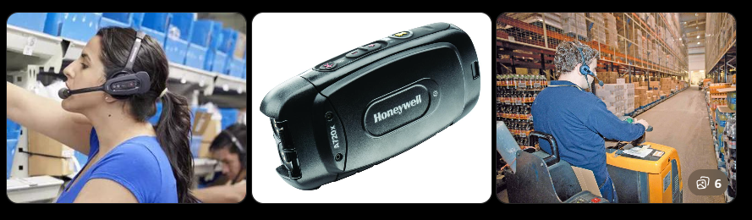
What’s Voice Picking?
VOICE is a warehouse order fulfillment system that helps warehouse associates pick products using voice instructions instead of paper pick lists or handheld devices.
Notes:
Flow of working:
Customer/stores places an order.
Warehouse Management System (WMS) creates picking tasks.
VOICE system sends instructions to the picker.
Picker wears a Honeywell/Vocollect headset and Talkman device.
Device says:
"Go to aisle 12, location 105."
"Pick 4 cases."
Picker confirms verbally.
Inventory is updated.
Order moves to shipping.

Slide 3
Why is VOICE Critical?
VOICE supports daily warehouse operations by:
Directing warehouse pickers
Processing order fulfillment
Updating inventory transactions
Supporting shipment preparation
If VOICE becomes unavailable:
Picking operations slow down
Order processing is delayed
Shipping schedules are impacted
Warehouse productivity decreases
Notes:
This Slide explains Business Impact of VOICE
VOICE is not just another application. It is part of the warehouse fulfillment process. Any outage or performance issue can directly impact picking and shipping operations

Slide 4
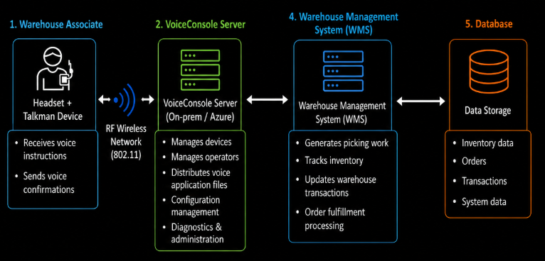
How VOICE impacts business?
Notes:
"This diagram shows how a VOICE picking transaction flows through the system."
"Warehouse associates use Honeywell Talkman devices and headsets to receive picking instructions and provide voice confirmations."
"These devices communicate over the warehouse wireless network with the VoiceConsole servers."
"VoiceConsole manages devices, operators, configurations, and voice application services."
"The VoiceConsole platform then interacts with the Warehouse Management System, which generates picking work, tracks inventory, and processes warehouse transactions."
"All operational data is ultimately stored in backend databases."
"Since warehouse operations depend on these VoiceConsole servers, monitoring their availability, performance, capacity, and connectivity is critical to ensuring uninterrupted picking operations."

Slide 5
Why Implementing a monitoring?
If VOICE goes down:
Pickers cannot receive instructions
Orders cannot be picked efficiently
Warehouse productivity drops
Shipping delays occur
Customer orders are impacted
That is why we monitor:
Server availability
CPU and memory
Disk utilization
Network traffic
Services and processes
Application health
Notes:
With that understanding of the VOICE infrastructure, let's look at the Dynatrace dashboard that provides visibility into the health and performance of these servers.
Also VOICE is not limited to a single warehouse location. The VoiceConsole infrastructure is deployed across approximately 42 distribution center sites, supporting warehouse picking operations throughout the network including the WH sites and DR Servers
Each site has its own VOICE server infrastructure that enables local warehouse operations.

Slide 6
Let’s Look into the Dynatrace Dashboard

Slide 7
Questions?

